Slide 1
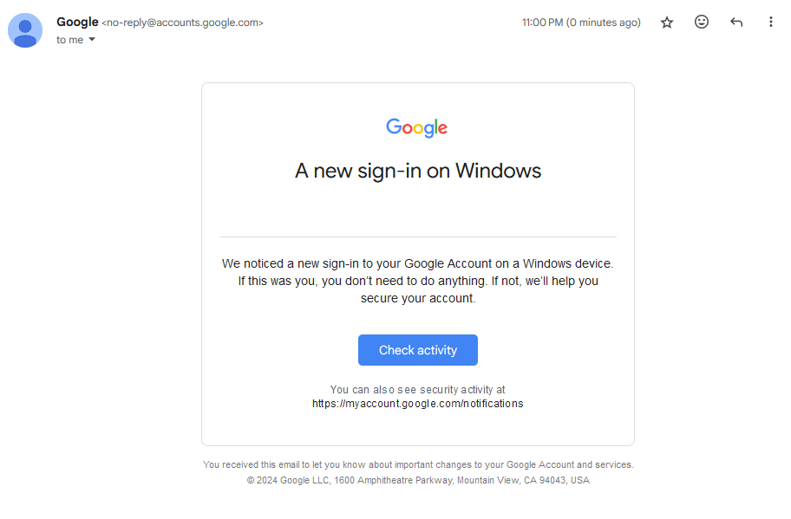

[your actual email address shown here]

Slide 2
[your actual email address shown here]
Genuine!

Slide 3
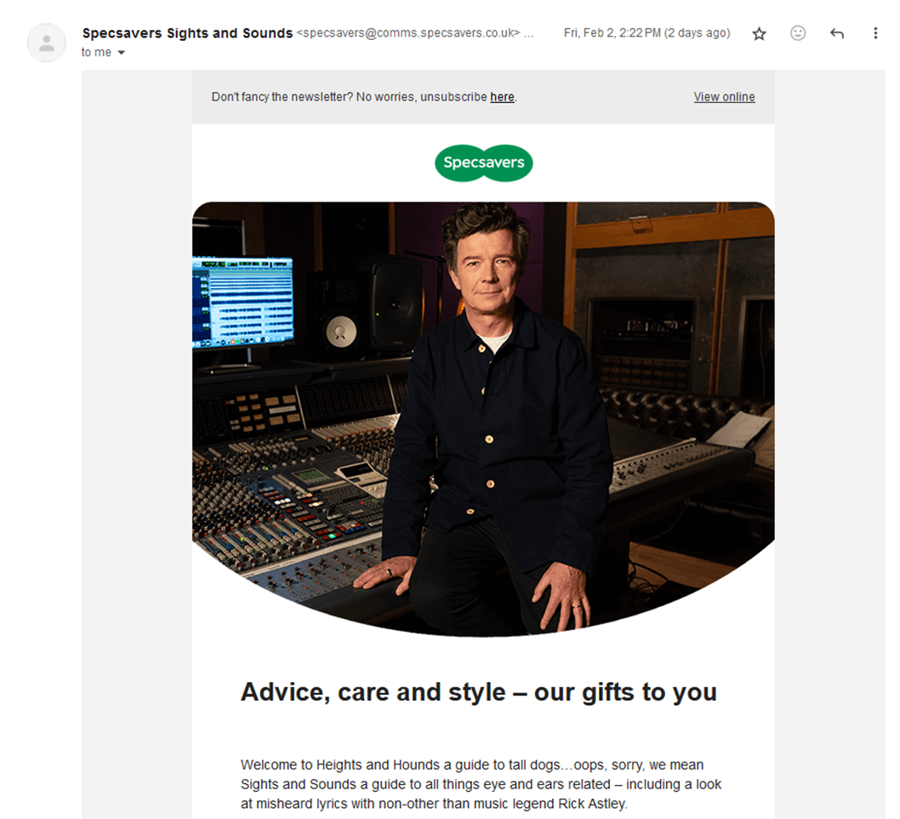
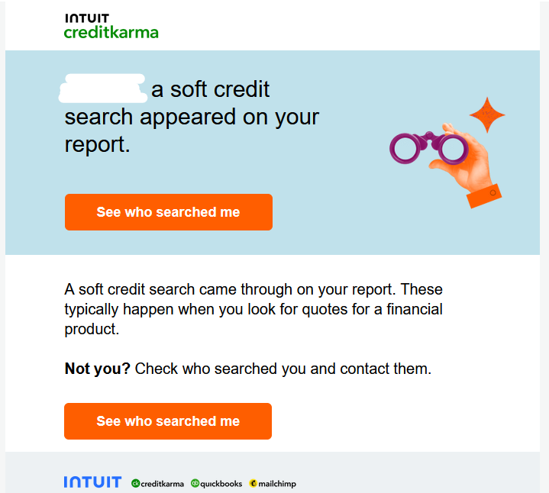
Kredit Carma notifications@mailkrecitcarma.co.uk... Thur, Sep 14 4:15PM (1 day ago)

Slide 4
Kredit Carma notifications@mailkrecitcarma.co.uk... Thur, Sep 14 4:15PM (1 day ago)
Fake!

Slide 5
From: IT Management [mailto:admin@data.mirosoft.biz]
Sent: 23 December 2023
To: [your email address]
Subject: ACCOUNT TERMINATION REQUEST NOTICE!!!
Server Message
Dear [your name]
Our records indicates that you recently made a requests to shut down your email [your actual email address shown here] account and in compliance with our data resention policy we will action this request in the next seven days.
If this requests was made in eroor please cancel this request now.
If you do not cancel this requests, your account will be shutdown shortly and any associated data may be lost permantly.
Kind Regards,
Microsoft Administrator
Cancel Request
http://mirosoft.biz/data/emails/index.php

Slide 6
From: IT Management [mailto:admin@data.mirosoft.biz]
Sent: 23 December 2023
To: [your email address]
Subject: ACCOUNT TERMINATION REQUEST NOTICE!!!
Server Message
Dear [your name]
Our records indicates that you recently made a requests to shut down your email [your actual email address shown here] account and in compliance with our data resention policy we will action this request in the next seven days.
If this requests was made in eroor please cancel this request now.
If you do not cancel this requests, your account will be shutdown shortly and any associated data may be lost permantly.
Kind Regards,
Microsoft Administrator
Fake!
Cancel Request
http://mirosoft.biz/data/emails/index.php

Slide 7

Credit Karma notifications@mailcrecitkarma.co.uk... Thur, Sep 14 8:15PM (1 day ago)

Slide 8
Credit Karma notifications@mailcrecitkarma.co.uk... Thur, Sep 14 8:15PM (1 day ago)
Genuine!

Slide 9
From: Dana Mulder [dana.mulder@barclay.bank.co.com]
Sent: 23 December 2023
Subject: Grandaughter’s birthday – urgent!
To: Dana Mulder [dana.mulder@barclay.bank.co.com]
I’m in meetings with the senior leadership team for the rest of the day and I completely forget today is my granddaughter birthday and I have not got her anything and I will not have time to get anything because of this meeting that I am in now and will be for the rest of this day now.
Please could you go on Amazonand buy me three £50 (fifty pound) digital gift cards and please email me the gift card codes?
I will reimbersue you first thing tomorrow with cash in hand. Really sorry to have to ask you this but I am panic that I forgot her birthday and she will be really upset if I did not bought her anything.
Many Thanks,
Dana

Slide 10
From: Dana Mulder [dana.mulder@barclay.bank.co.com]
Sent: 23 December 2023
Subject: Grandaughter’s birthday – urgent!
To: Dana Mulder [dana.mulder@barclay.bank.co.com]
I’m in meetings with the senior leadership team for the rest of the day and I completely forget today is my granddaughter birthday and I have not got her anything and I will not have time to get anything because of this meeting that I am in now and will be for the rest of this day now.
Please could you go on Amazonand buy me three £50 (fifty pound) digital gift cards and please email me the gift card codes?
I will reimbersue you first thing tomorrow with cash in hand. Really sorry to have to ask you this but I am panic that I forgot her birthday and she will be really upset if I did not bought her anything.
Many Thanks,
Dana
Fake!

Slide 11
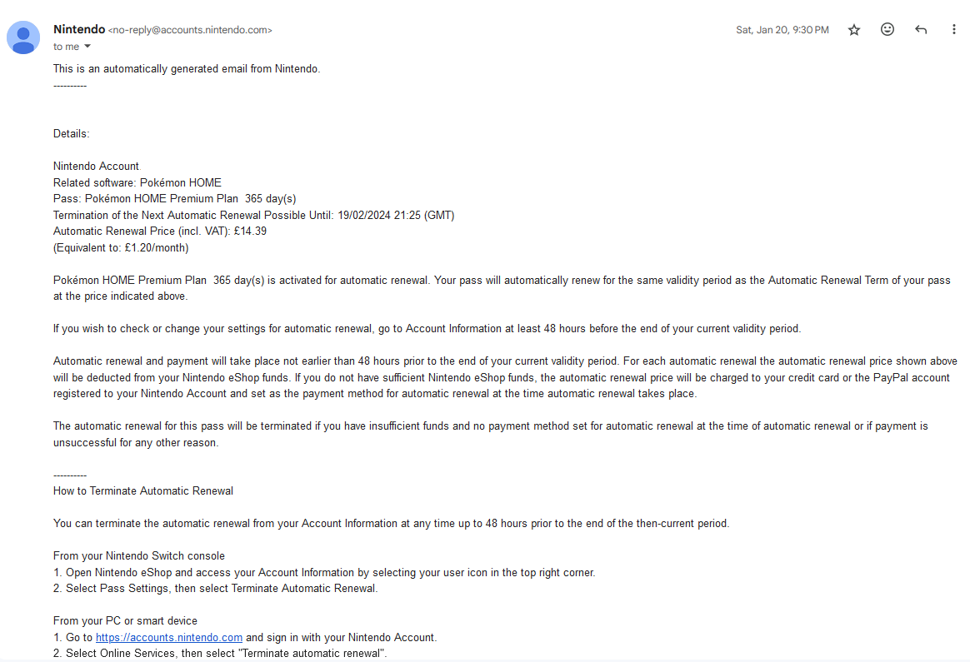

Slide 12
Genuine!

Slide 13
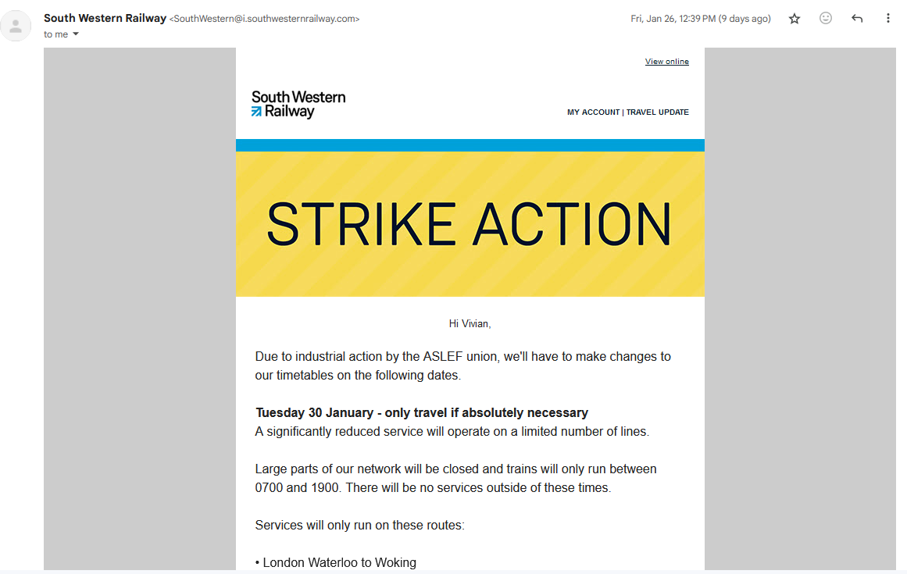
South Western Railway <natonalrailway@i.natonalrailway.com> Tues, Jan 13 8:32AM (2 days ago)
http://tickets.natonalrailway.com

Slide 14
South Western Railway <natonalrailway@i.natonalrailway.com> Tues, Jan 13 8:32AM (2 days ago)
http://tickets.natonalrailway.com
Fake!

Slide 15
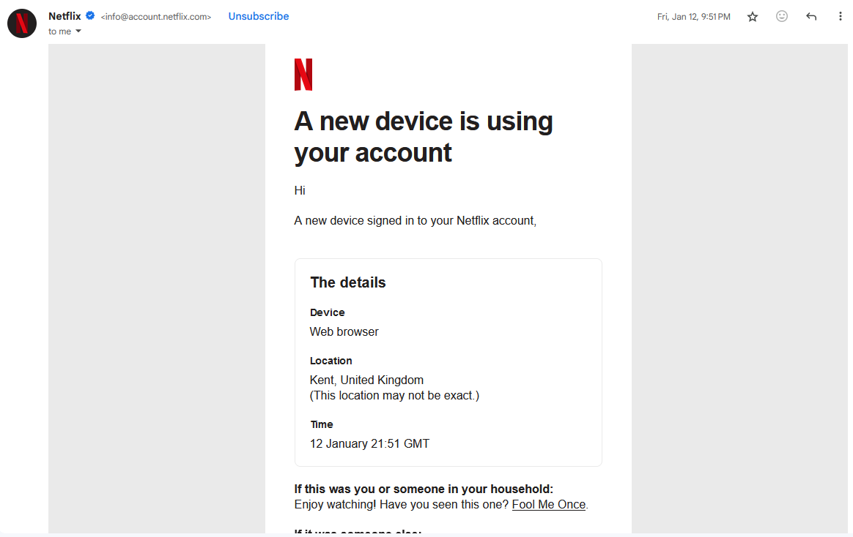
[your actual name]
[your actual email address shown here]

Slide 16
[your actual name]
[your actual email address shown here]
Genuine!

